Slide 1
Make PowerPoint Presentations with R Markdown
An Introduction

Slide 2
Why would you want to create a PowerPoint presentation from R Markdown?

Slide 3
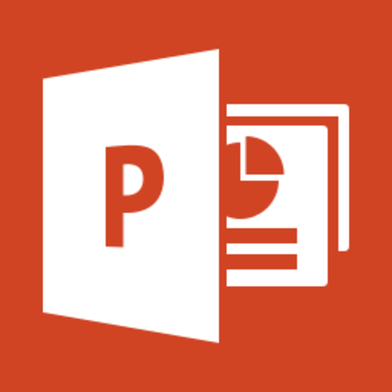
Everyone knows PowerPoint
Standard communication tool
Especially in business
People “speak” PowerPoint
It’s useful – it works
Flexible enough to get the job done
You can make slides fast
Everyone has personal experience with it

Slide 4

But your work is coded in R
Your code is your product
Your output is a manifestation of your code
Plots, tables, model output, etc.
R Markdown makes your work reproducible
You choose the output format
Reports, apps, dashboards,
HTML, PDF, Microsoft Word,
but not PowerPoint … UNTIL NOW!

Slide 5
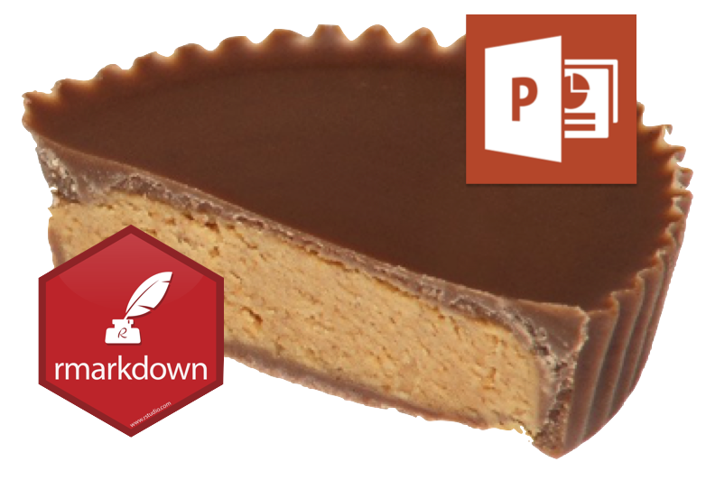
Now you can author PowerPoint presentations from R Markdown.
As of RStudio version 1.2 you can render PowerPoint presentations from the IDE. This combines two great things – PowerPoint and R Markdown. Think of it as the Rheese’s Peanut Butter Cup of presentation software.

Slide 6
Demo: Create a PowerPoint Presentation with RStudio

Slide 7
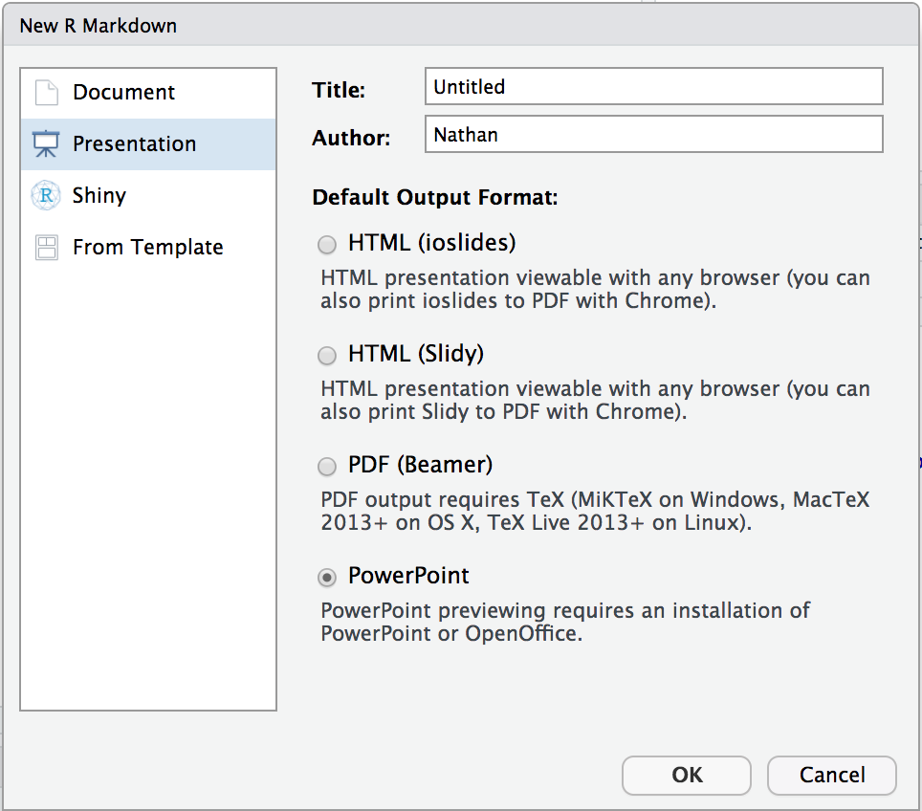
Quick Example
Create a new R Markdown Document:
File > New File > R Markdown > Presentation
Then choose:
Knit to PowerPoint
Open the presentation:
RStudio Desktop – Opens automatically
RStudio Server – Downloads automatically
You will need PowerPoint on your workstation
Render programmatically
IDE not required
rmarkdown::render("in.Rmd", output_format = "powerpoint_presentation")

Slide 8

Benefits
Your whole presentation becomes a reproducible document
Output code, tables, and plots directly to slides
Makes it easier to share your insights with a wider audience
Spend more time coding, less time generating presentations
Communicating with R Markdown

Slide 9
How does it work?

Slide 10
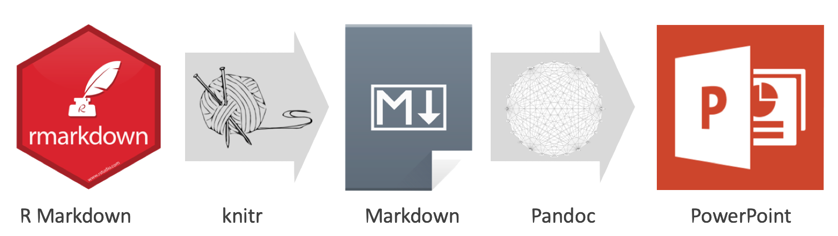
R Markdown > Markdown > PowerPoint

Slide 11

Pandoc
What is Pandoc?
Document converter (e.g. Markdown to HTML)
Open source software Bundled in RStudio IDE
PowerPoint output added in Pandoc 2
Initial release in December 2017
Included in upcoming RStudio IDE v1.2
Included in RStudio Connect as of v1.6.4

Slide 12
Other options
These popular R packages offer fine grain functions for creating PowerPoint presentations.
ReportRs
OfficeR
R2PPT
Displayr

Slide 13
Use Cases

Slide 14
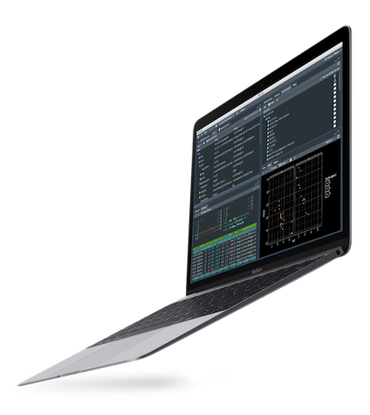
1. Render presentation then customize
Output text, tables, and plots to PowerPoint
Modify and/or copy slides into your final presentation
Example

Slide 15
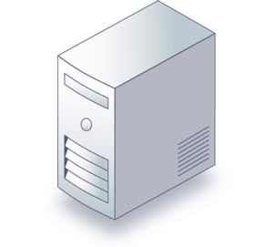
2. Publish RStudio Connect
RStudio Connect
Publishing platform for R
Runs your R code
Share Shiny apps, R Markdown reports, and much more
Output entire presentations with R Markdown
Render programmatically on schedule
Distribute via email
Accept user input
Example

Slide 16
Features

Slide 17

Markdown features
Most markdown elements
Text formats
Lists
Math expressions
Hyperlinks
As well as these nifty features
Images and tables with captions
Speaker notes
Templates
Example

Slide 18

Supports R Code (of course!)
Code syntax highlighting
Table output
Plots (e.g ggplot)
HTML Widgets
Example

Slide 19

Shiny
Point viewers to your Shiny app
Install webshot package
Install phanotmjs: webshot::install_phantomjs()
Call knitr::include_app()
A linked image of your app will be included in your presentation
Example

Slide 20
Resources

Slide 21

Where to get help
rmarkdown.rstudio.com
R Markdown: The Definitive Guide
Getting started
Troubleshooting
community.rstudio.com
Submitting issues

Slide 22

Frequently asked questions
Getting started
How do I use custom templates?
How do I structure my presentation?
Troubleshooting
Why does my presentation not open properly?
How do I put an image and text on the same slide?
How do I control the placement of images and text?

Slide 23

Vignettes
github.com/sol-eng/powerpoint
Getting Started
Markdown Features
Images and Tables
Columns and Notes
Templates
Structuring the Presentation
R Code Chunks

Slide 24
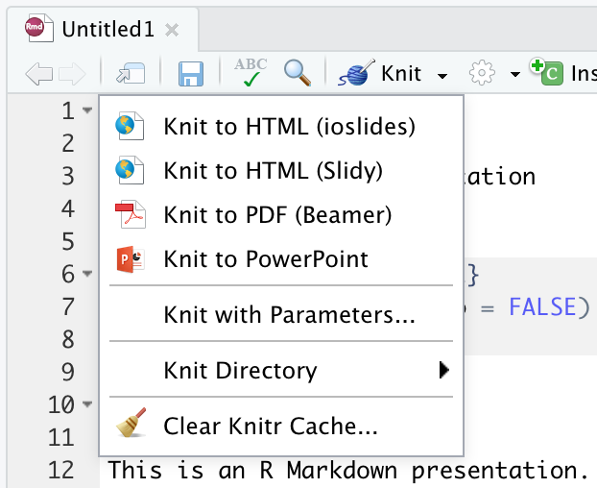
Try out the new RStudio v1.2 Preview
Click image to download the RStudio v1.2 Preview

Slide 25
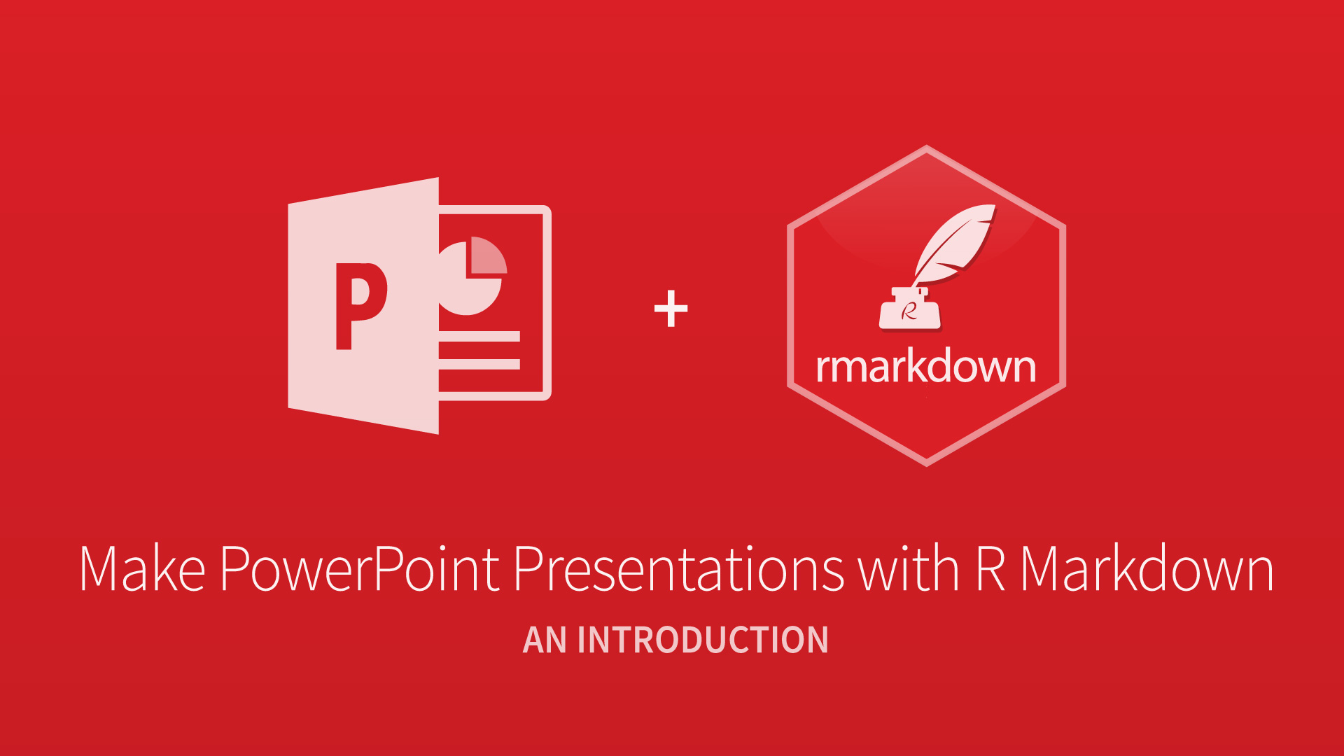
Thank you

